Slide 1


Slide 2
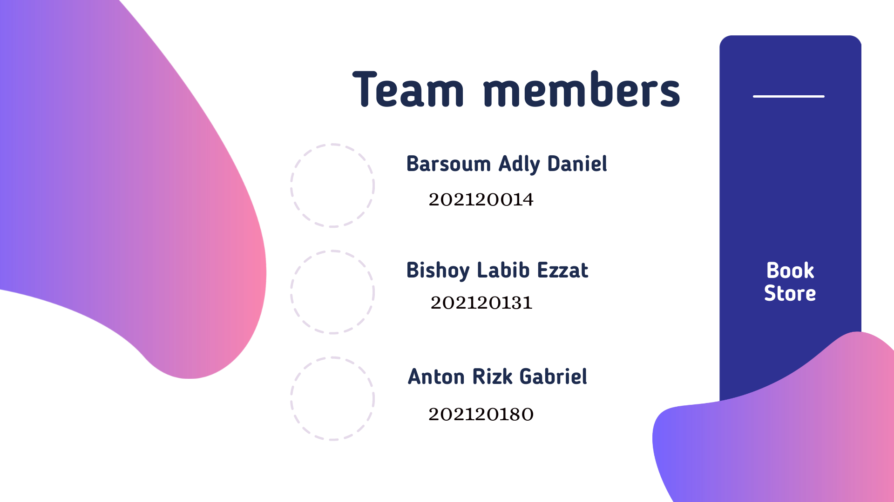



Team members
@Short w fanila w Lap

Slide 3

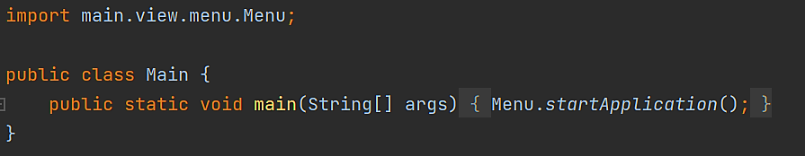
Code
class Main

Slide 4
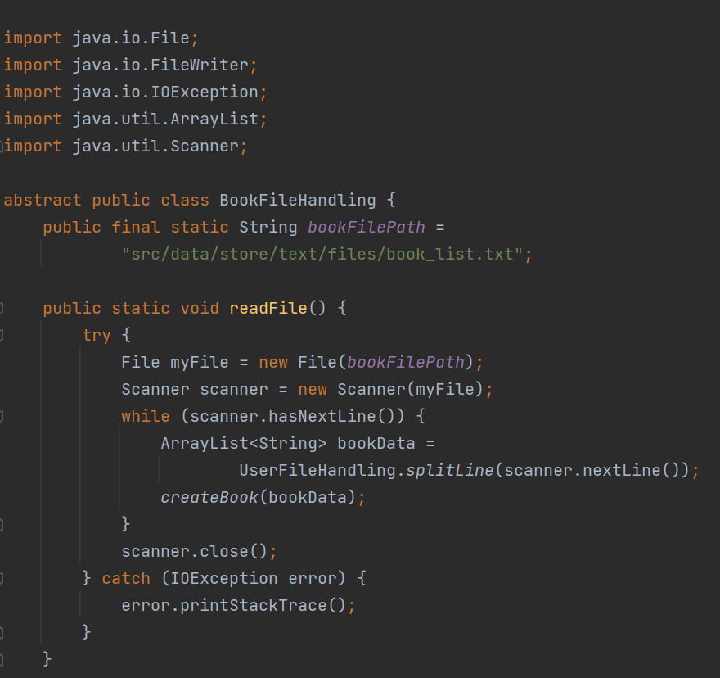
Code
Class BookFileHandling

Slide 5
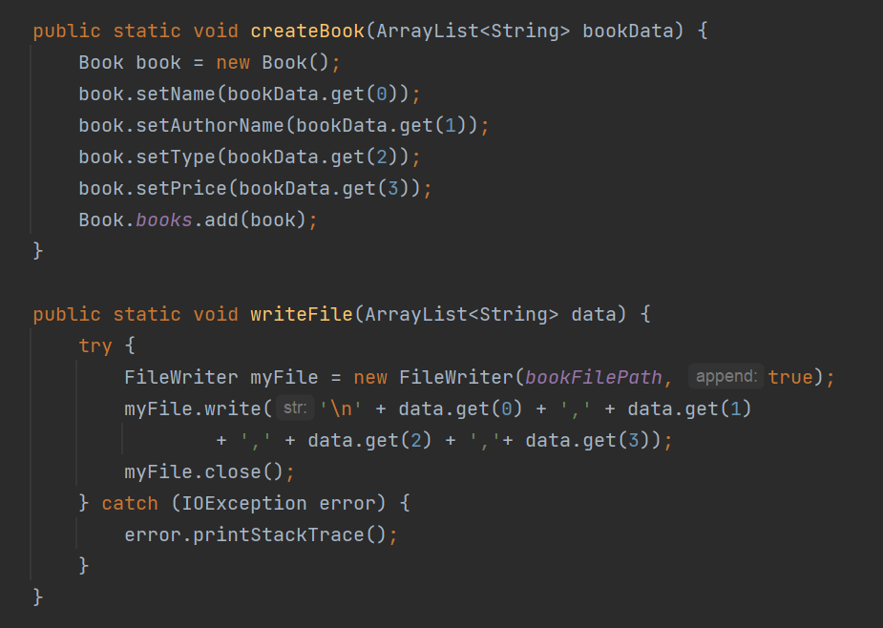
Code
Class BookFileHandling

Slide 6
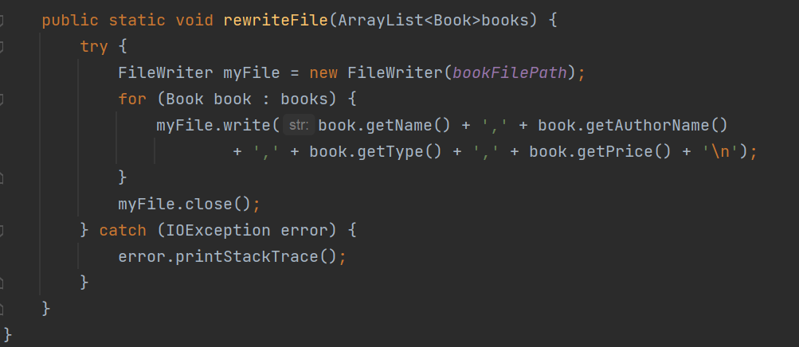
Code
Class BookFileHandling

Slide 7
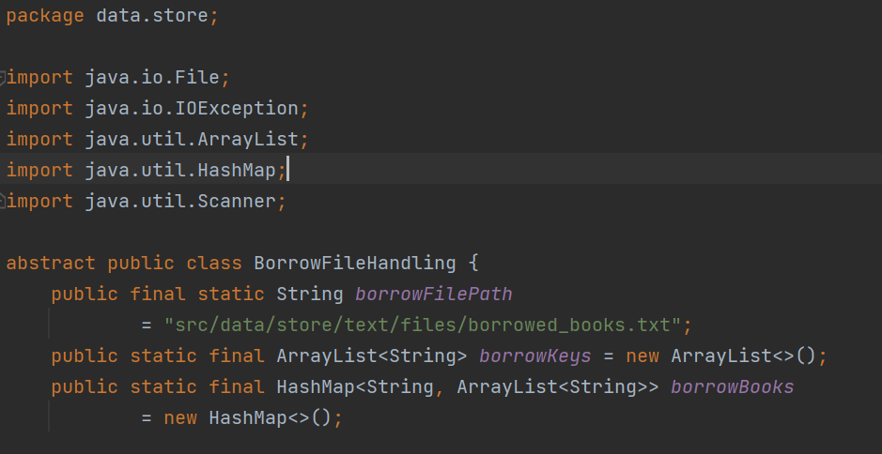
Code
Class BorrowFileHandling

Slide 8
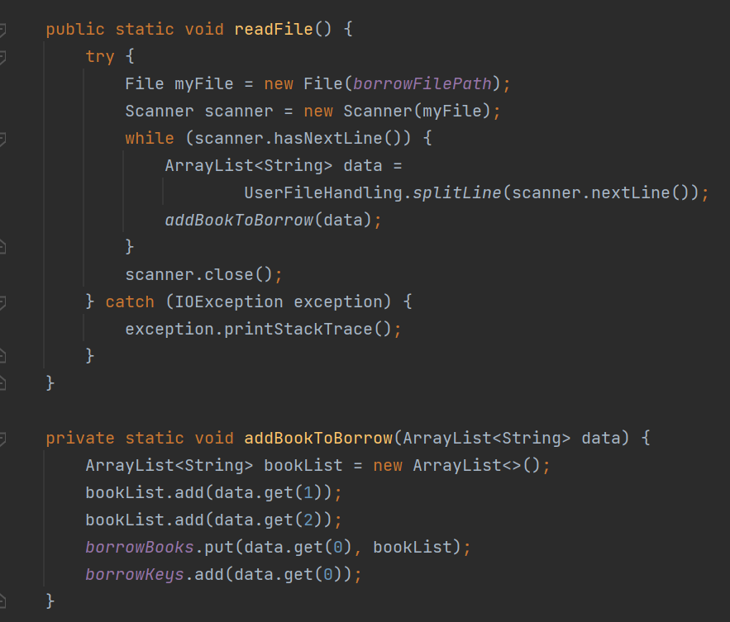
Code
Class BorrowFileHandling

Slide 9
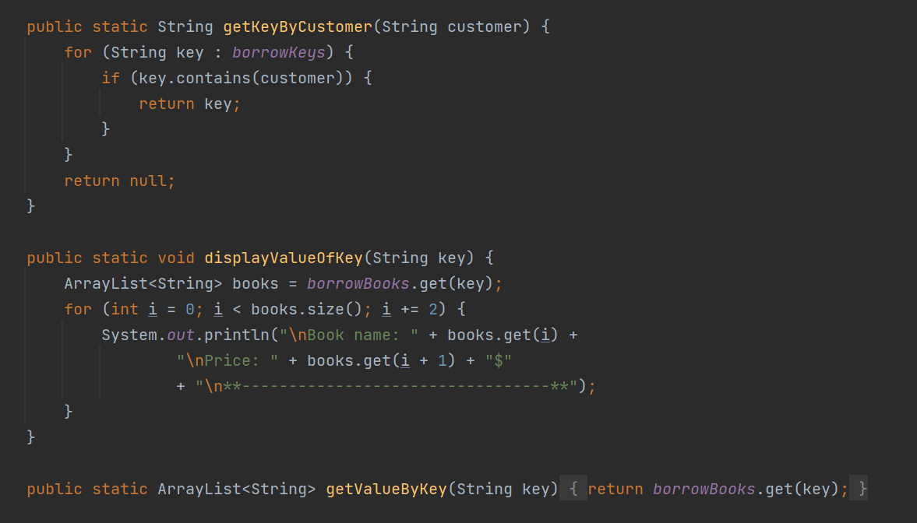
Code
Class BorrowFileHandling

Slide 10
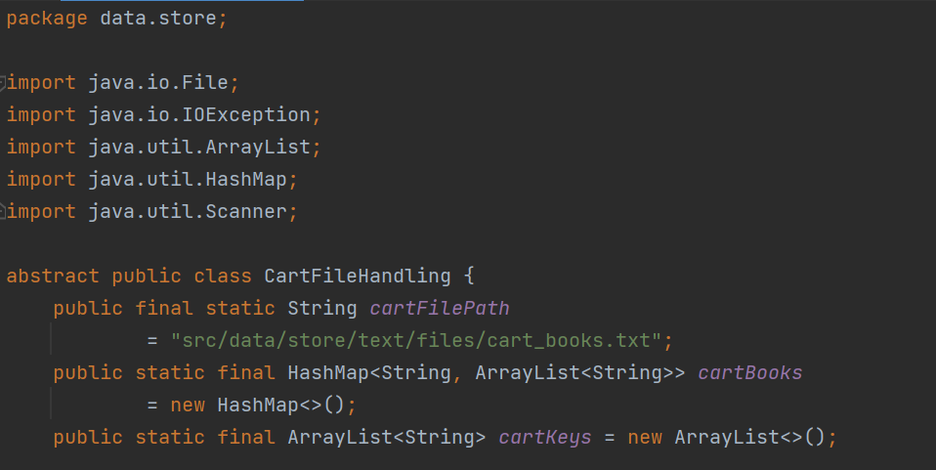
Code
Class CartFileHandling

Slide 11
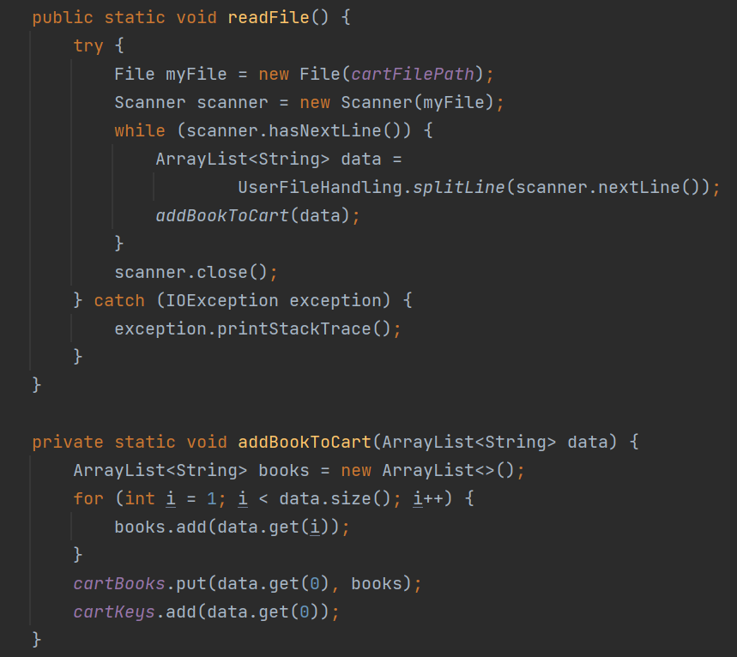
Code
Class CartFileHandling

Slide 12
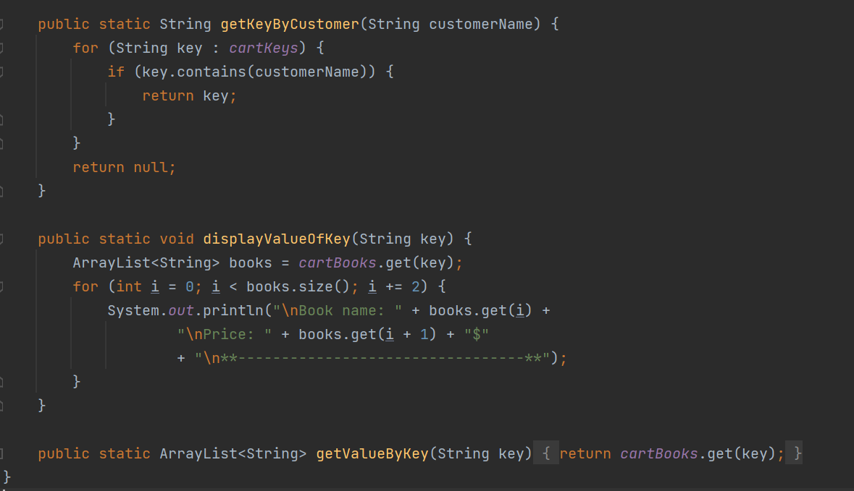
Code
Class CartFileHandling

Slide 13
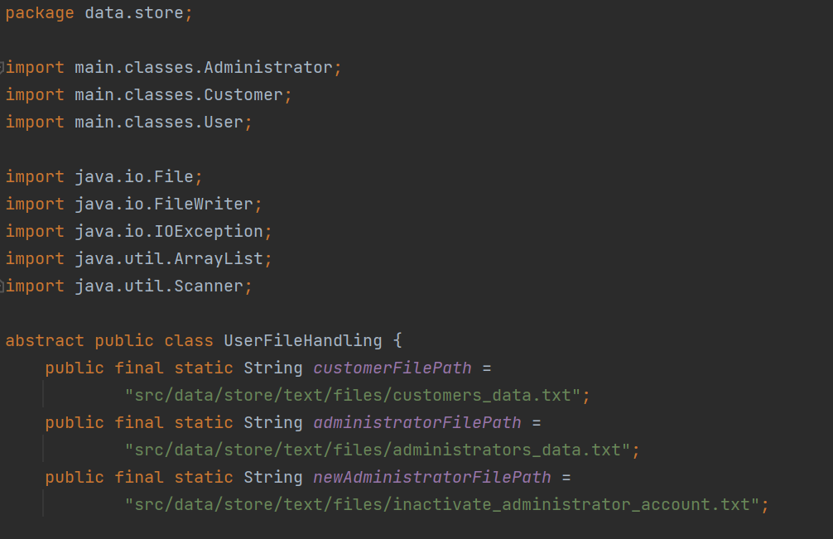
Code
Class UserFileHandling

Slide 14
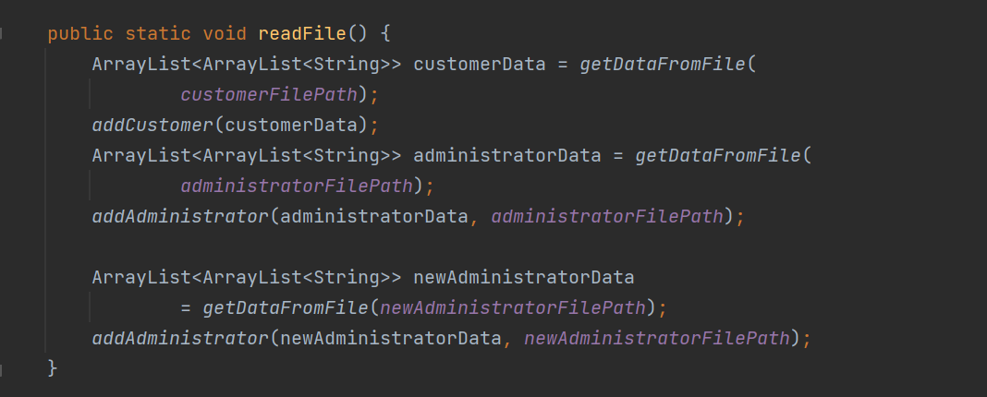
Code
Class UserFileHandling

Slide 15
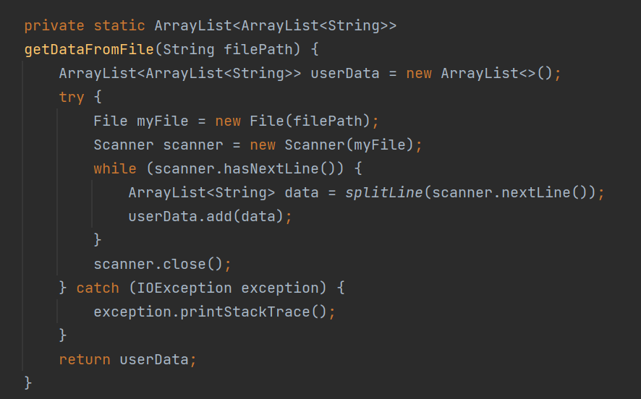
Code
Class UserFileHandling

Slide 16
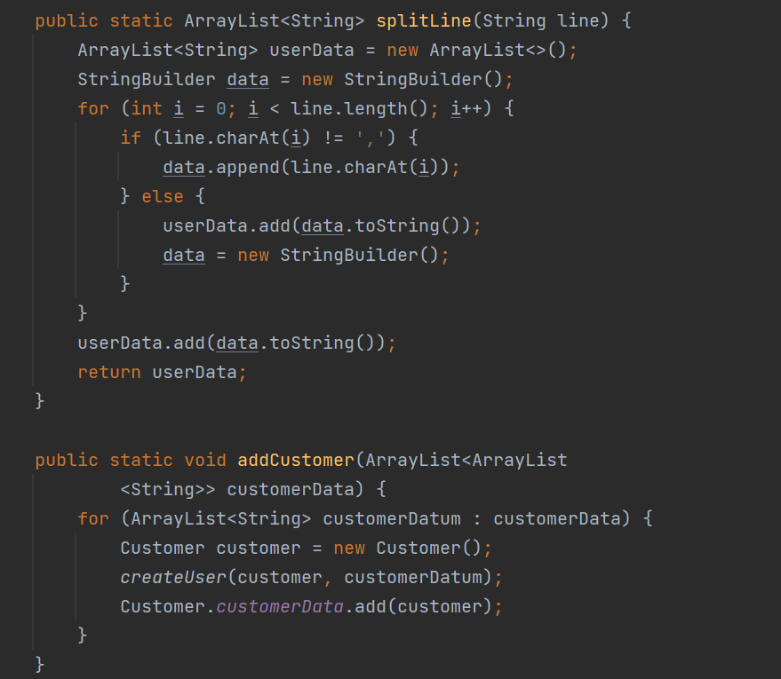
Code
Class UserFileHandling

Slide 17
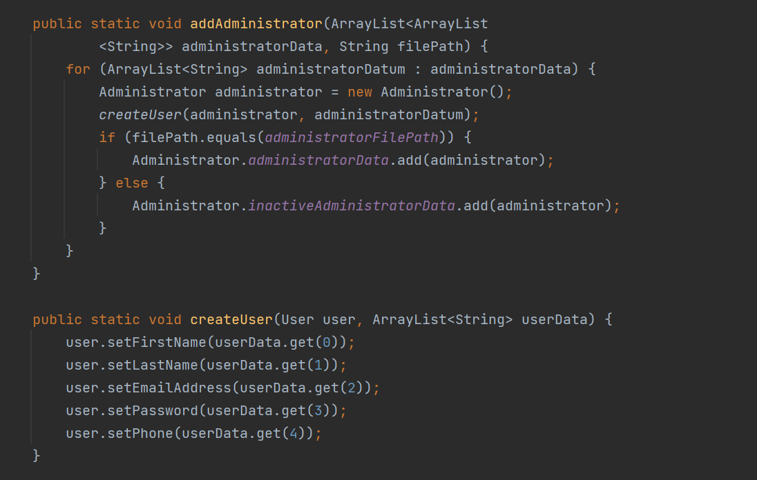
Code
Class UserFileHandling

Slide 18
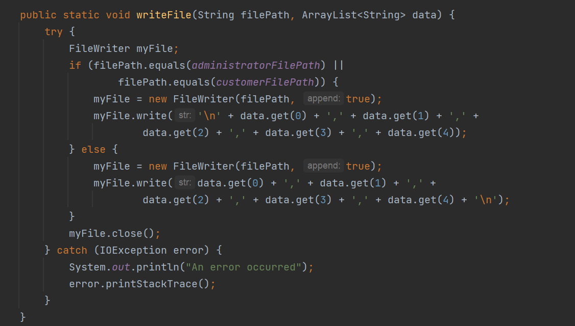
Code
Class UserFileHandling

Slide 19
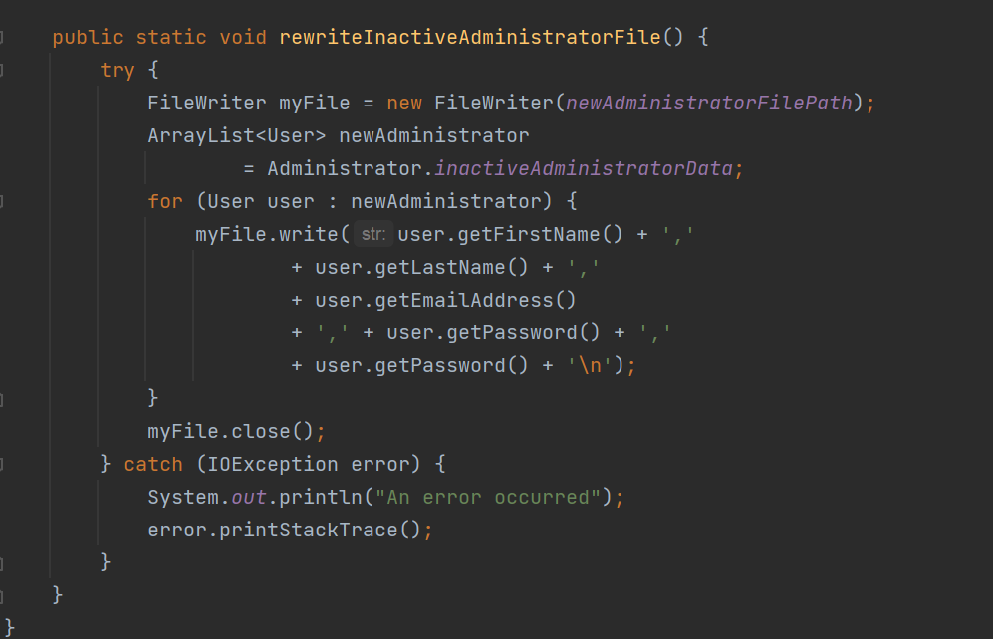
Code
Class UserFileHandling

Slide 20
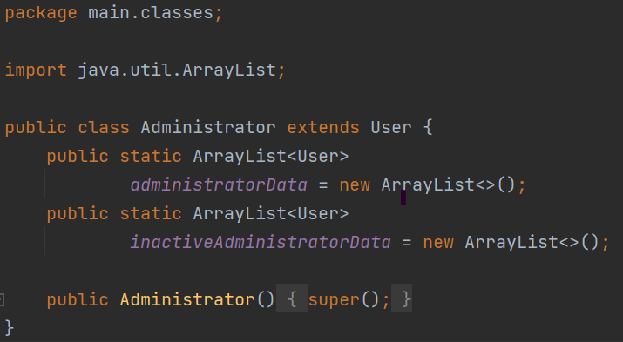
Code
Class Administrator

Slide 21
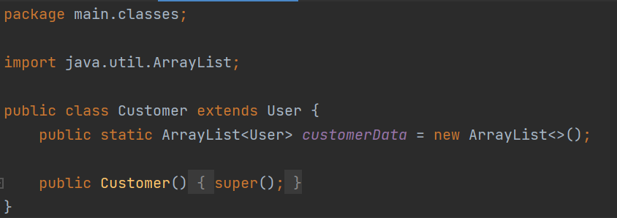
Code
Class Customer

Slide 22
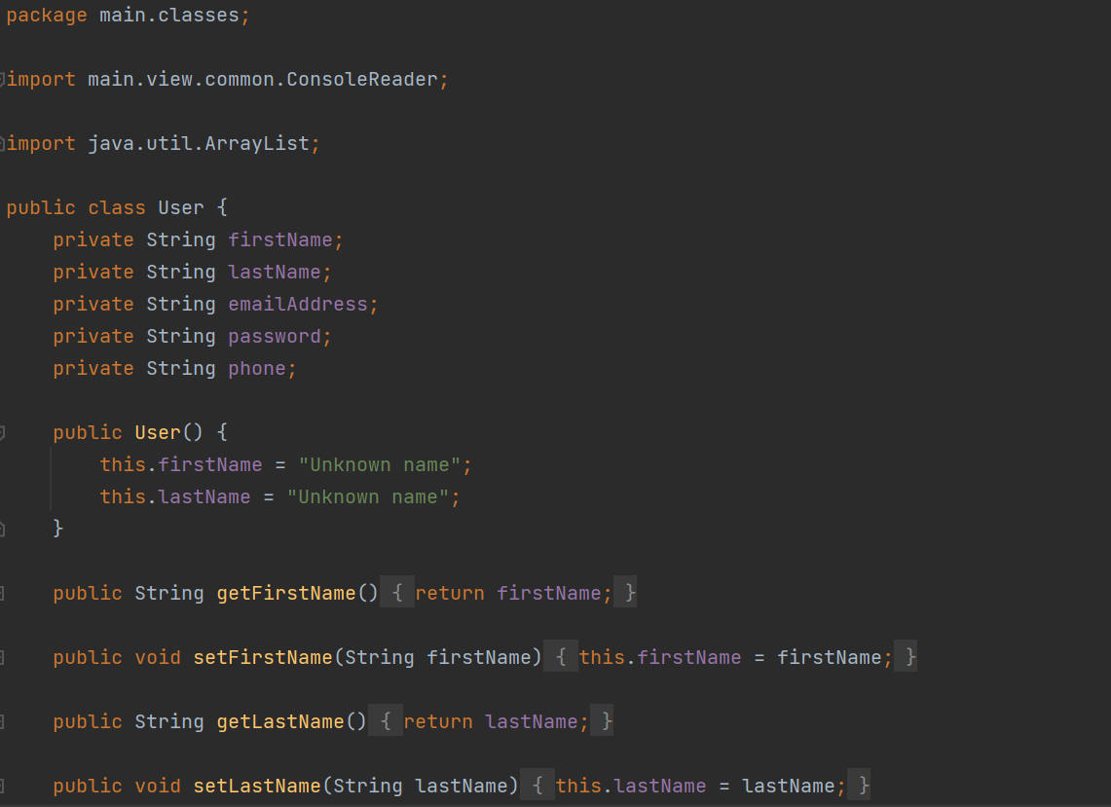
Code
Class User

Slide 23
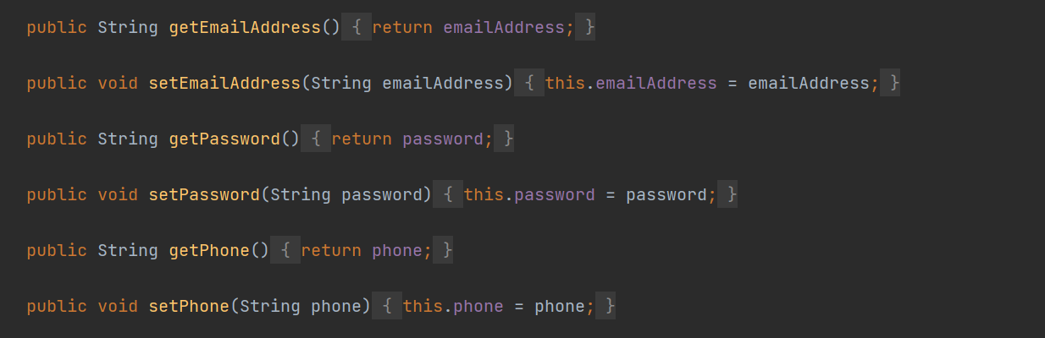
Code
Class User

Slide 24
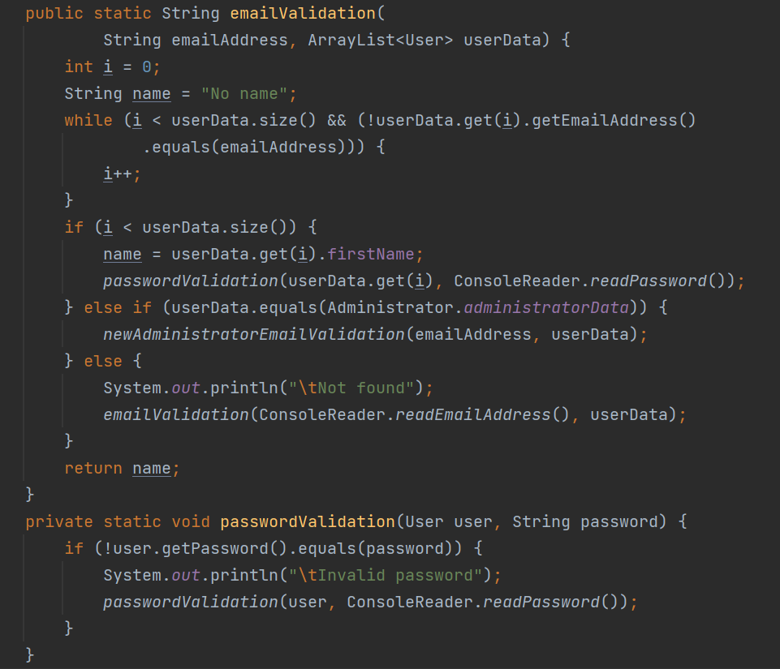
Code
Class User

Slide 25
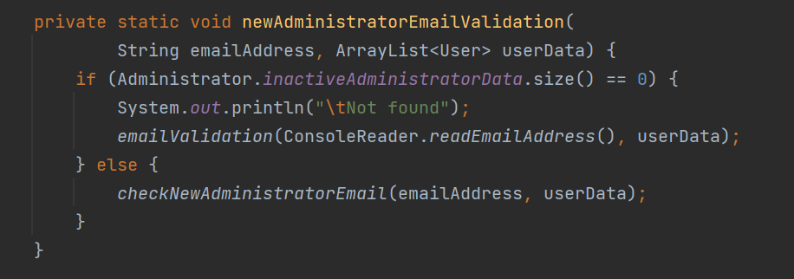
Code
Class User

Slide 26
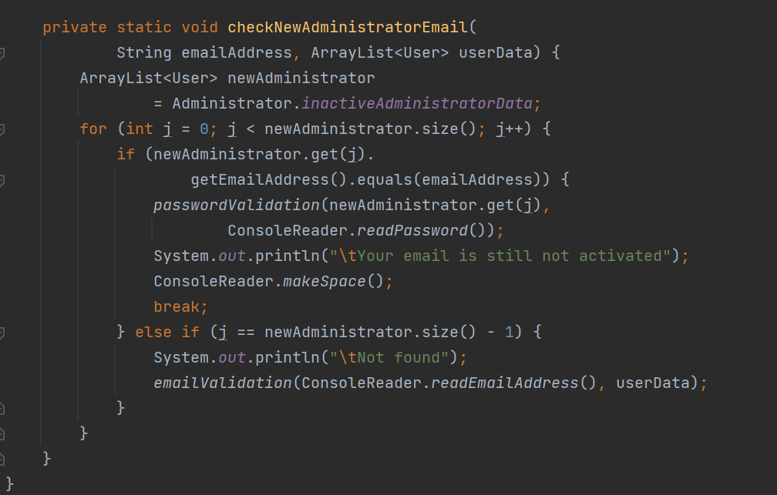
Code
Class User

Slide 27
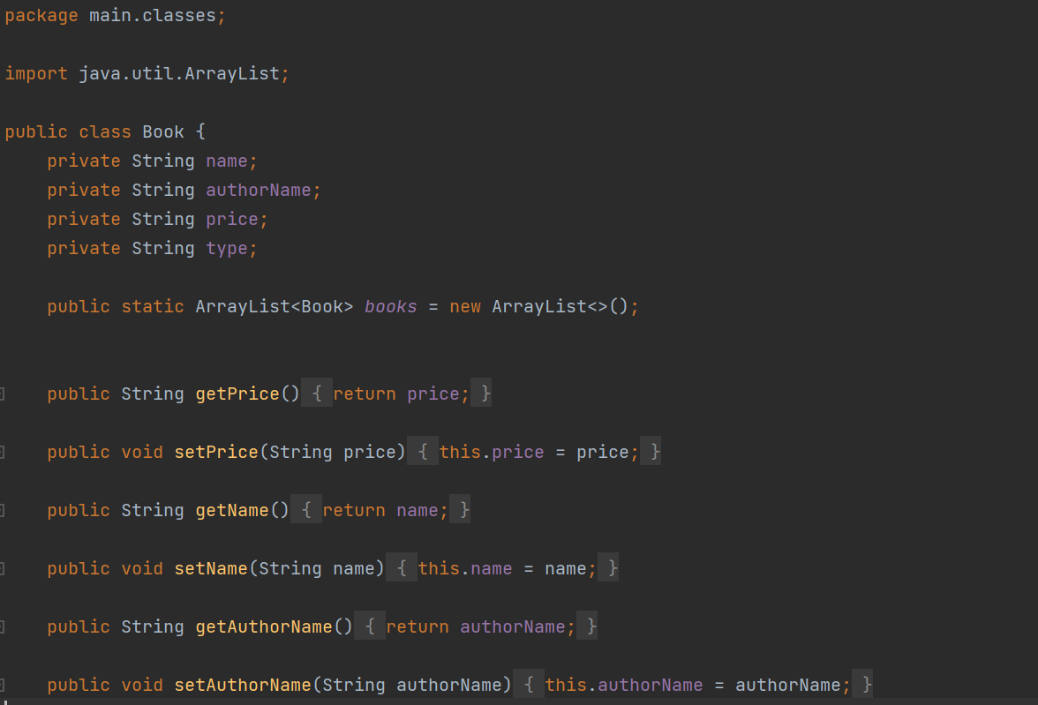
Code
Class Book

Slide 28
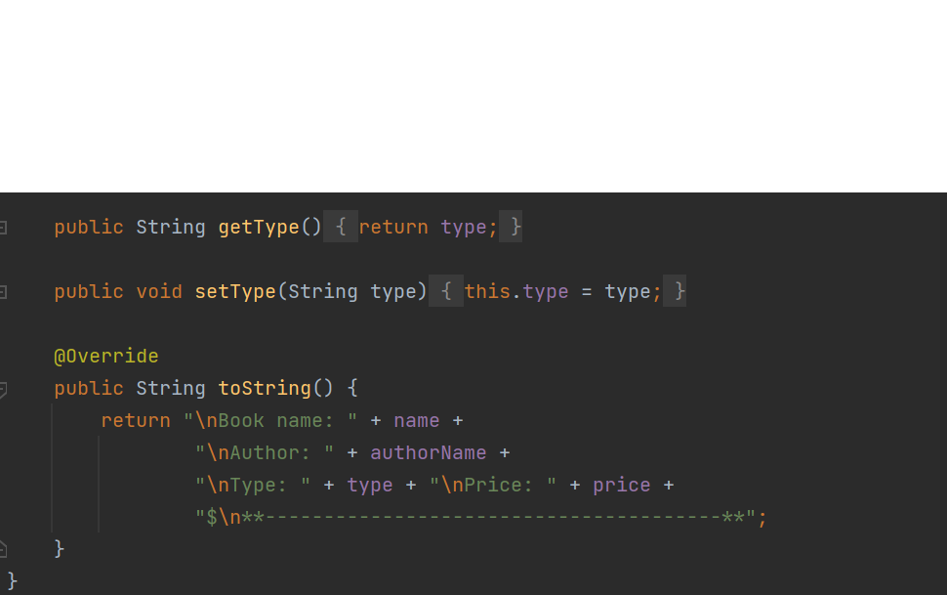
Code
Class Book

Slide 29
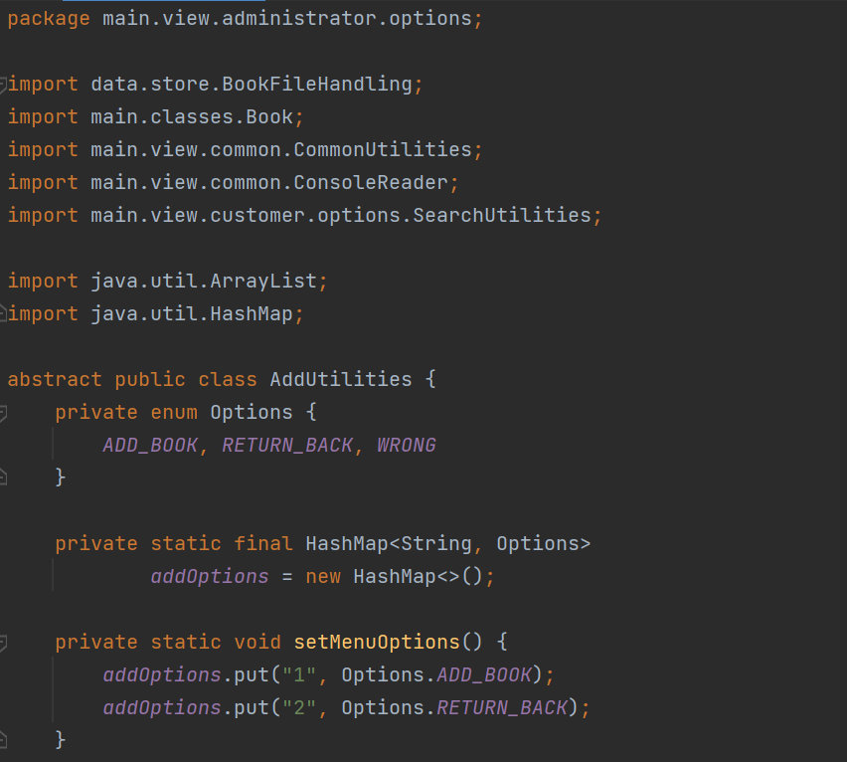
Code
Class AddUtilities

Slide 30
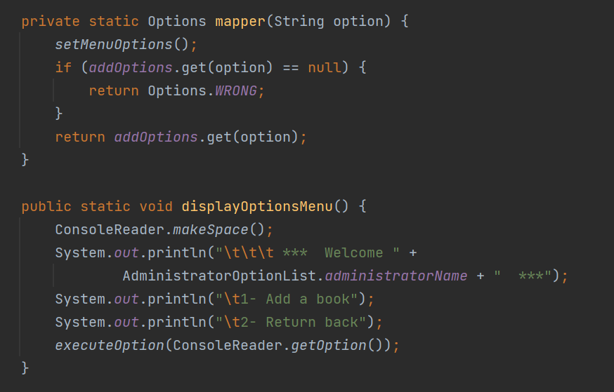
Code
Class AddUtilities

Slide 31
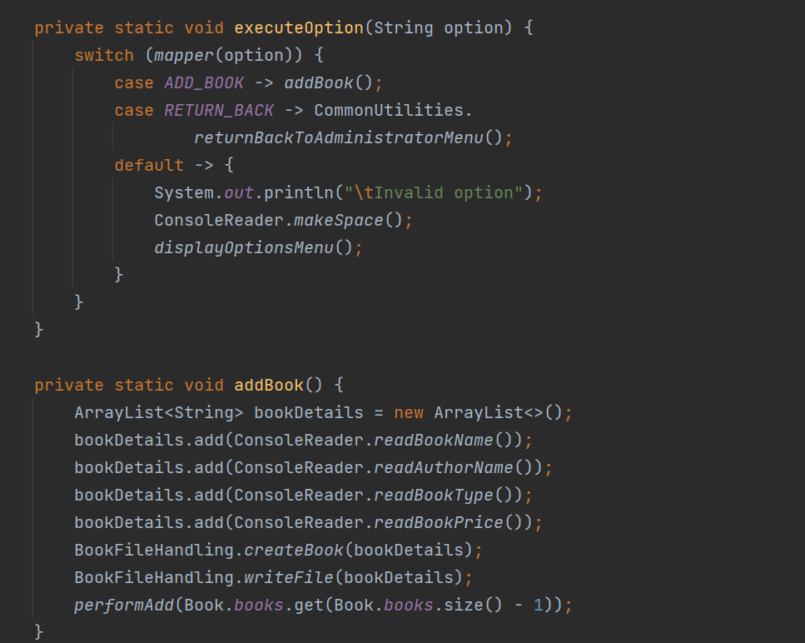
Code
Class AddUtilities

Slide 32
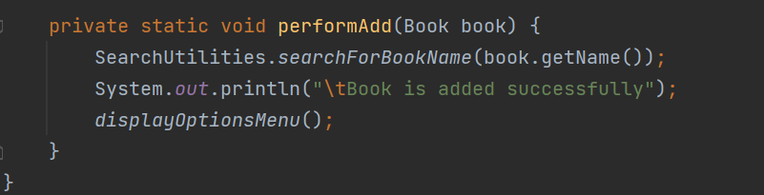
Code
Class AddUtilities

Slide 33
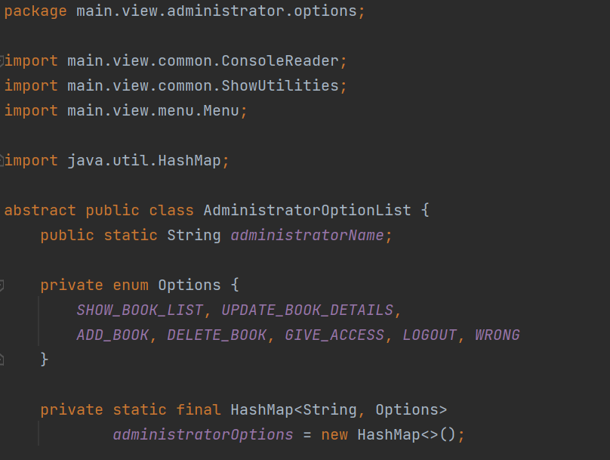
Code
Class
AdministratorOptionList

Slide 34
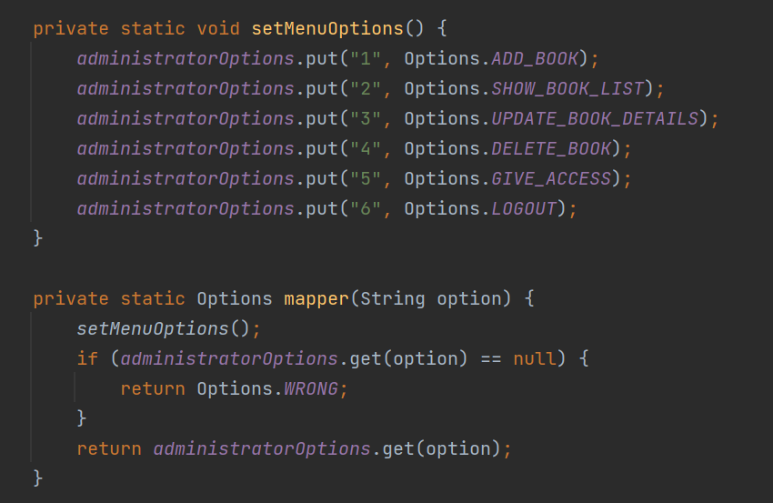
Code
Class
AdministratorOptionList

Slide 35
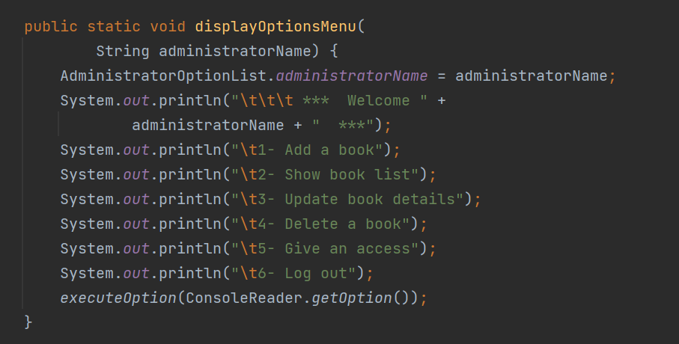
Code
Class
AdministratorOptionList

Slide 36
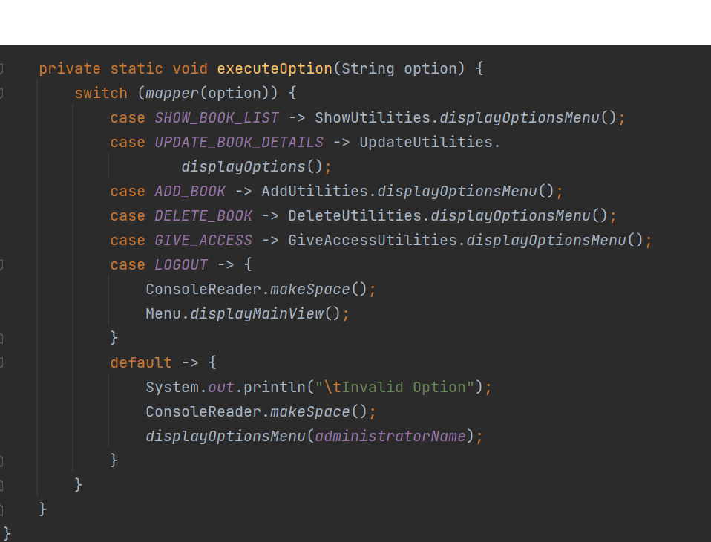
Code
Class
AdministratorOptionList

Slide 37
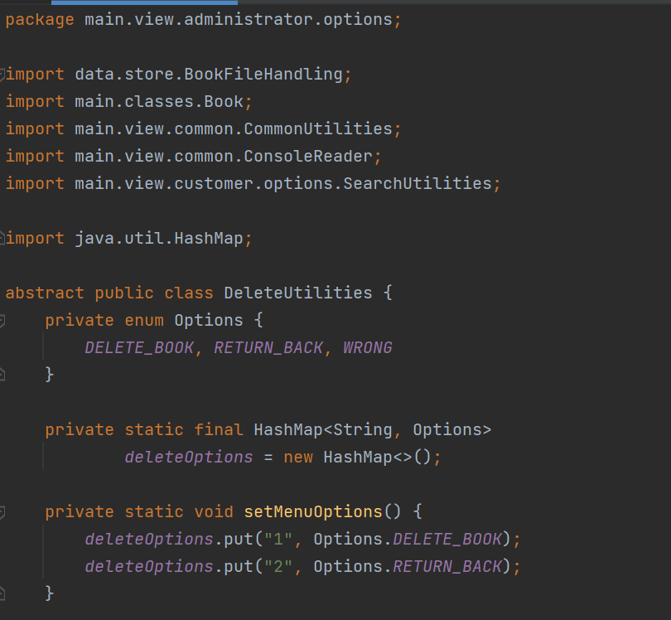
Code
Class DeleteUtilities

Slide 38
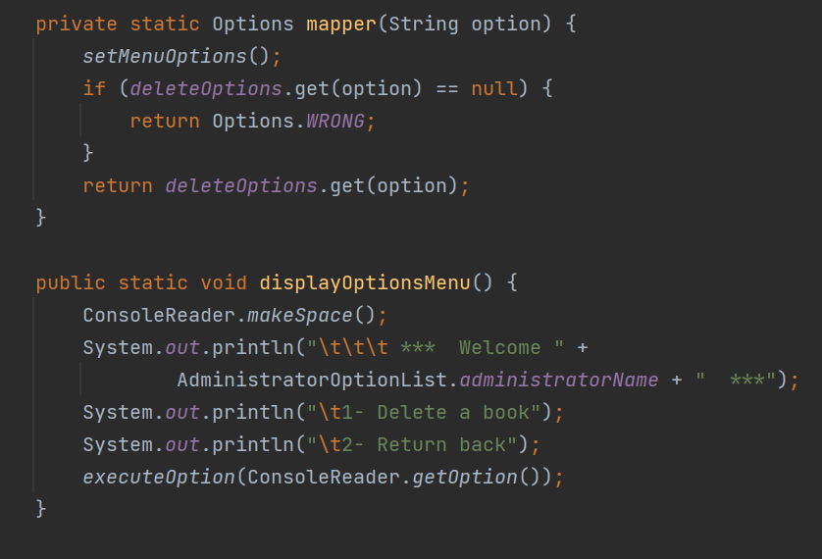
Code
Class DeleteUtilities

Slide 39
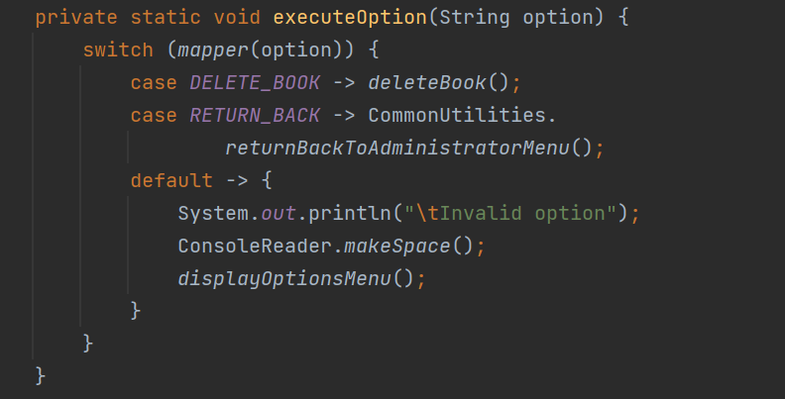
Code
Class DeleteUtilities

Slide 40
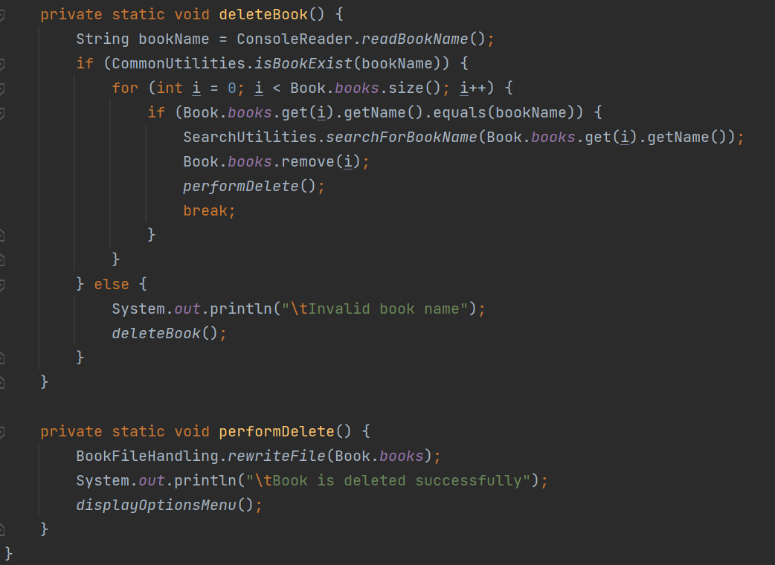
Code
Class DeleteUtilities

Slide 41
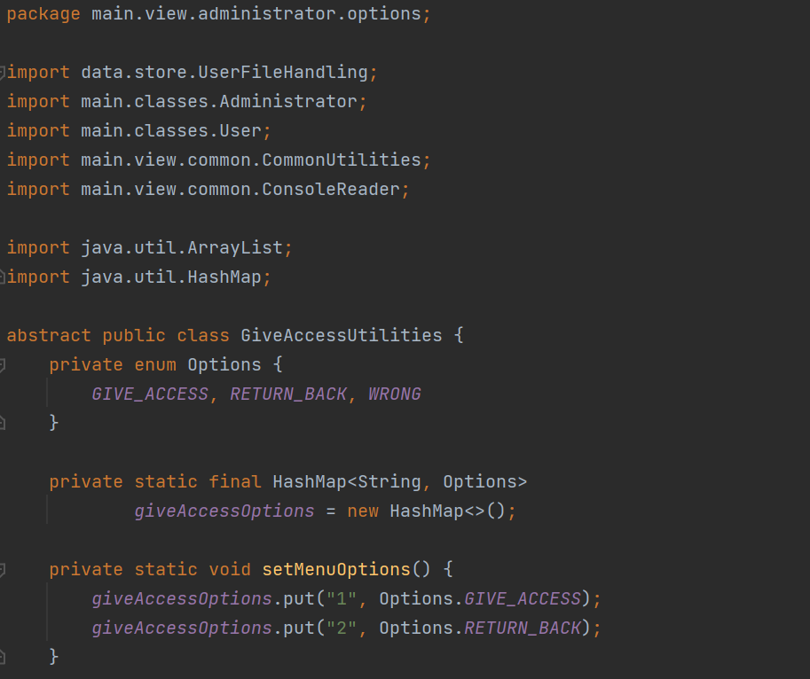
Code
Class GiveAccessUtilities

Slide 42
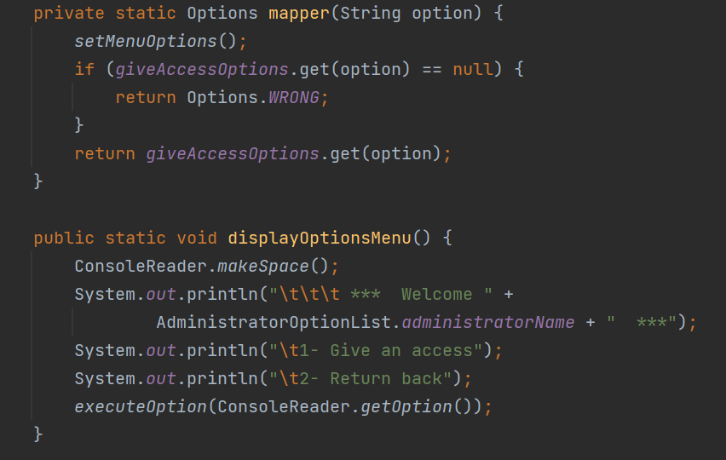
Code
Class GiveAccessUtilities

Slide 43
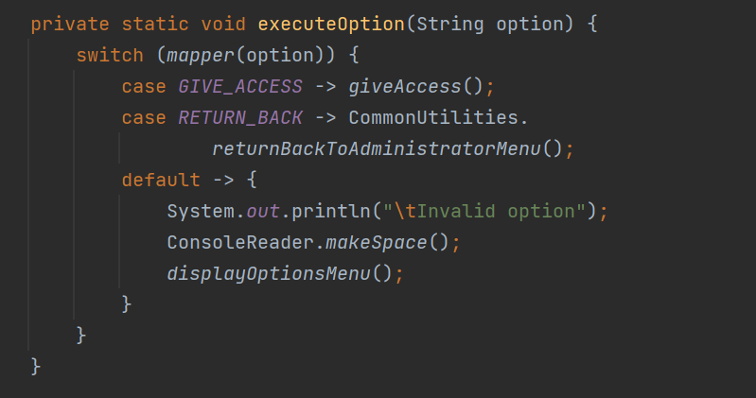
Code
Class GiveAccessUtilities

Slide 44
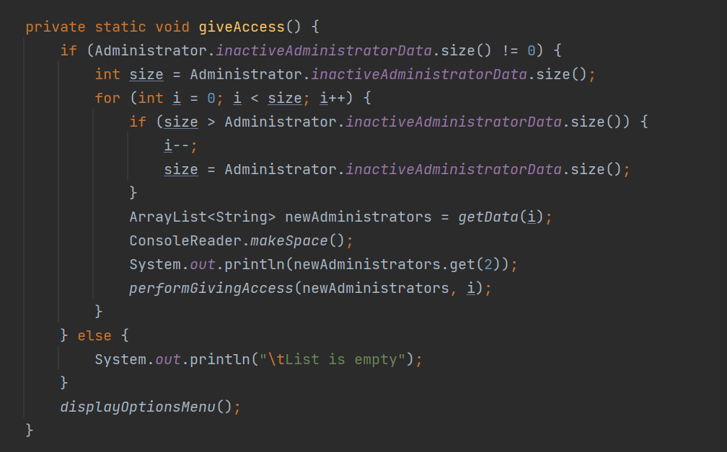
Code
Class GiveAccessUtilities

Slide 45
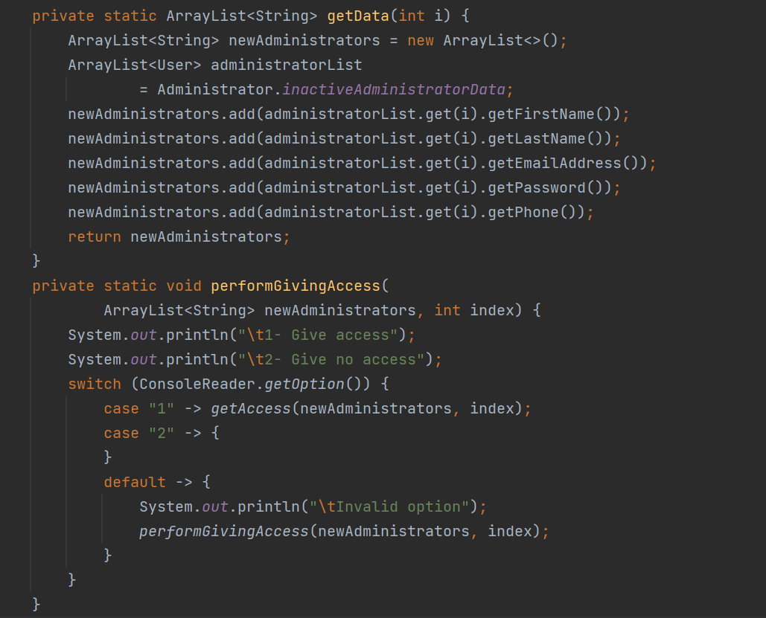
Code
Class GiveAccessUtilities

Slide 46
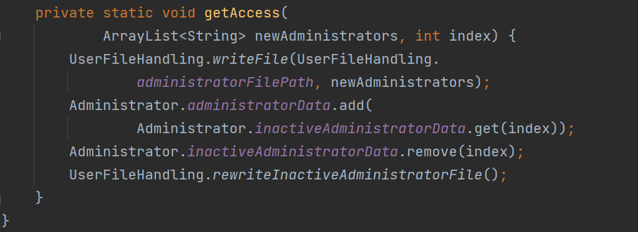
Code
Class GiveAccessUtilities

Slide 47
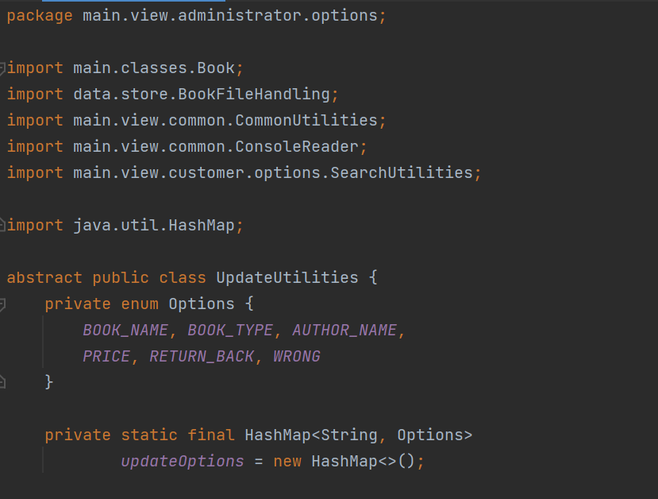
Code
Class UpdateUtilities

Slide 48
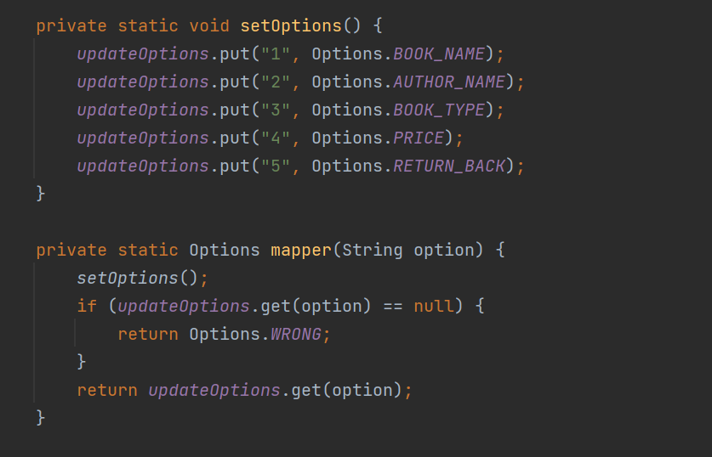
Code
Class UpdateUtilities

Slide 49
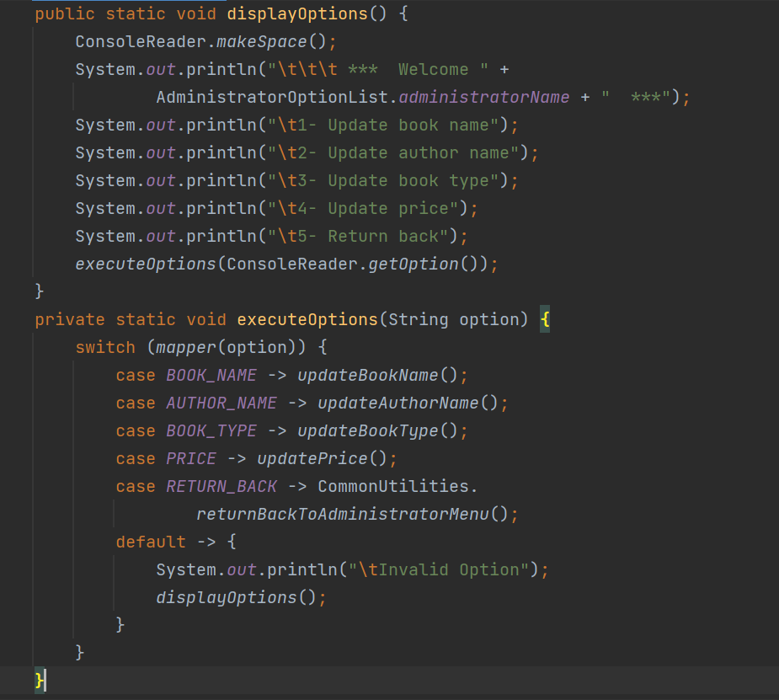
Code
Class UpdateUtilities

Slide 50
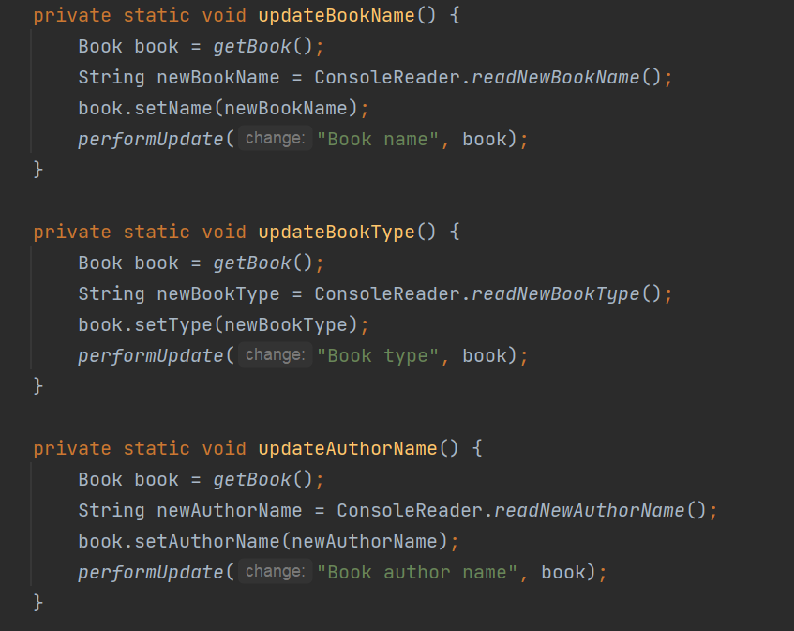
Code
Class UpdateUtilities

Slide 51
Code
Class UpdateUtilities

Slide 52
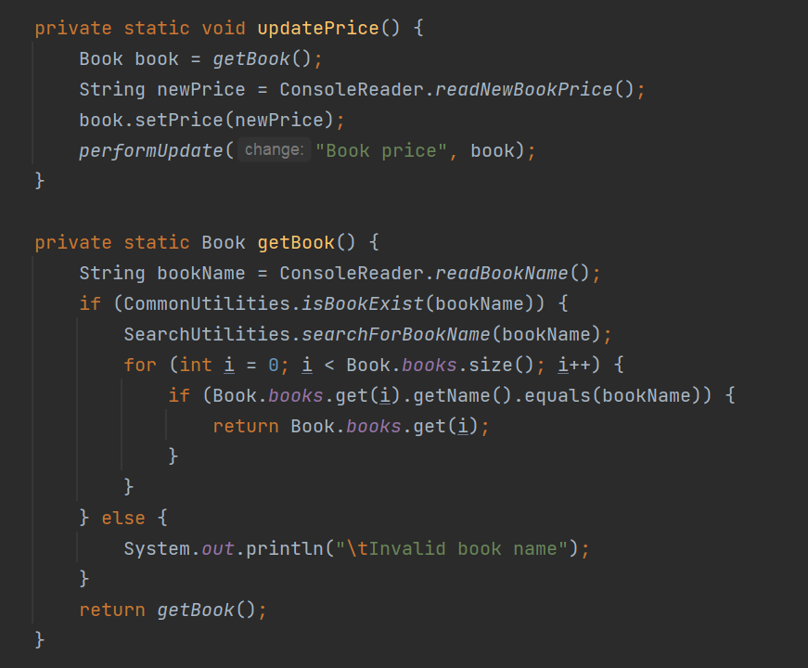
Code
Class UpdateUtilities

Slide 53

Code
Class UpdateUtilities

Slide 54

Code
Class CommonUtilities

Slide 55

Code
Class CommonUtilities

Slide 56

Code
Class CommonUtilities

Slide 57

Code
Class CommonUtilities

Slide 58

Code
Class CommonUtilities

Slide 59

Code
Class ConsoleReader

Slide 60

Code
Class ConsoleReader

Slide 61

Code
Class ConsoleReader

Slide 62

Code
Class ConsoleReader

Slide 63

Code
Class ConsoleReader

Slide 64

Code
Class ConsoleReader

Slide 65

Code
Class ShowUtilities

Slide 66

Code
Class ShowUtilities

Slide 67

Code
Class ShowUtilities

Slide 68

Code
Class ShowUtilities

Slide 69

Code
Class ShowUtilities

Slide 70

Code
Class ShowUtilities

Slide 71

Code
Class BorrowUtilities

Slide 72

Code
Class BorrowUtilities

Slide 73

Code
Class BorrowUtilities

Slide 74

Code
Class BorrowUtilities

Slide 75

Code
Class BorrowUtilities

Slide 76

Code
Class BorrowUtilities

Slide 77
Code
Class BorrowUtilities

Slide 78

Code
Class BorrowUtilities

Slide 79

Code
Class BuyUtilities

Slide 80

Code
Class BuyUtilities

Slide 81

Code
Class BuyUtilities

Slide 82

Code
Class BuyUtilities

Slide 83


Code
Class BuyUtilities

Slide 84

Code
Class BuyUtilities

Slide 85

Code
Class BuyUtilities

Slide 86

Code
Class BuyUtilities

Slide 87

Code
Class
CustomerAdvancedOptionList

Slide 88

Code
Class
CustomerAdvancedOptionList

Slide 89

Code
Class
CustomerAdvancedOptionList

Slide 90

Code
Class
CustomerOptionList

Slide 91

Code
Class
CustomerOptionList

Slide 92

Code
Class
CustomerOptionList

Slide 93

Code
Class
CustomerOptionList

Slide 94

Code
Class
KnowBillUtilities

Slide 95

Code
Class
KnowBillUtilities

Slide 96

Code
Class
KnowBillUtilities

Slide 97

Code
Class
KnowBillUtilities

Slide 98

Code
Class
KnowBillUtilities

Slide 99

Code
Class
KnowBillUtilities

Slide 100

Code
Class
KnowBillUtilities

Slide 101

Code
Class
SearchUtilities

Slide 102

Code
Class
SearchUtilities

Slide 103

Code
Class
SearchUtilities

Slide 104

Code
Class
SearchUtilities

Slide 105

Code
Class
SearchUtilities

Slide 106

Code
Class
SearchUtilities

Slide 107

Code
Class Menu

Slide 108

Code
Class Menu

Slide 109

Code
Class MenuOptions

Slide 110

Code
Class MenuOptions

Slide 111

Code
Class OptionUtilities

Slide 112

Code
Class LogIn

Slide 113

Code
Class LogIn

Slide 114

Code
Class LogIn

Slide 115

Code
Class SignUp

Slide 116

Code
Class SignUp

Slide 117

Code
Class SignUp

Slide 118

Code
Class SignUp

Slide 119

Code
Class SignUp

Slide 120


